Slide 1
VBA for MS Excel
Ahmad AL Kawam

Slide 2
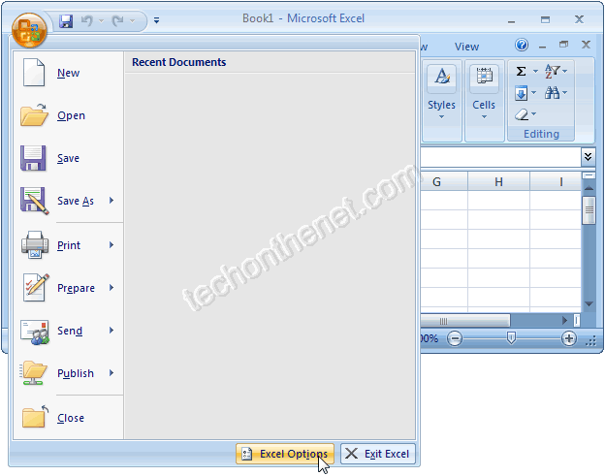
Open the Visual Basic Editor in Excel 2007
Click on the Microsoft Office button in the top left of the Excel window and then click on the Excel Options button

Slide 3
Open the Visual Basic Editor in Excel 2007
When the Excel Options window appears, click on the Popular option on the left. Select the option called "Show Developer tab in the Ribbon". Then click on the OK button.

Slide 4
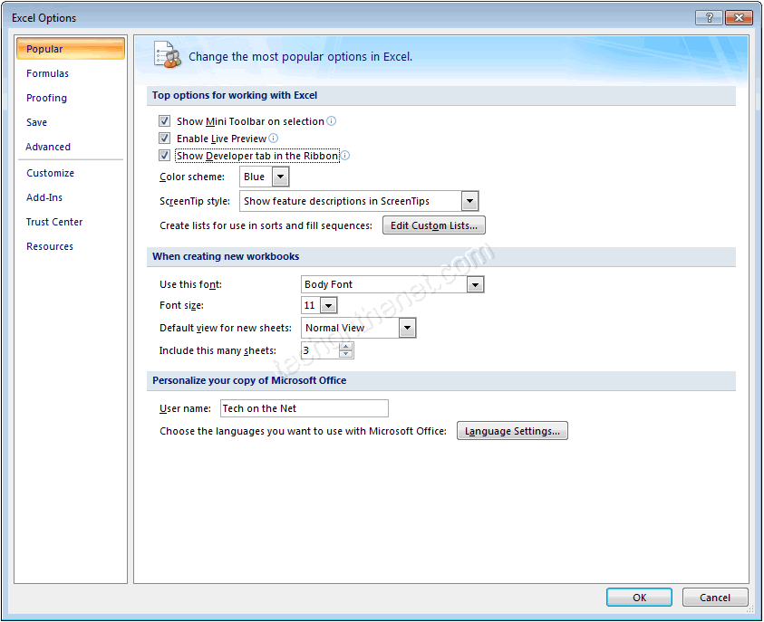

Slide 5
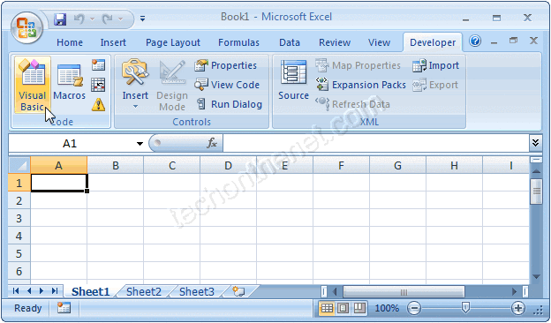
Open the Visual Basic Editor in Excel 2007
Select the Developer tab from the toolbar at the top of the screen. Then click on the Visual Basic option in the Code group.

Slide 6
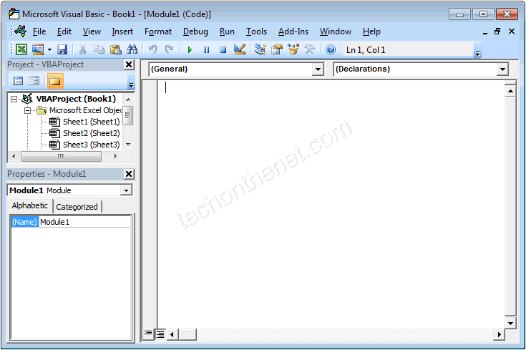
Open the Visual Basic Editor in Excel 2007
Now the Microsoft Visual Basic editor should appear and you can view your VBA code.

Slide 7
Variables and Data Types
To use some values in code, you must first create them
In the world of computer programming, a variable is a value you ask the computer to temporarily store in its memory while the program is running.

Slide 8
Declaring a Variable
In order to reserve that storage area, you have to let the computer know. Letting the computer know is referred to as declaring the variable. To declare a variable, you start with the Dim word.
Dim VariableName As DataType

Slide 9
Declaring a Variable
There are rules you should follow when naming your variables:
The name of a variable must begin with a letter or an underscore
After starting with a letter or an underscore, the name can be made of letters, underscores, and digits in any order
The name of a variable cannot have a period
The name of a variable can have up to 255 characters.
The name of a variable must be unique in the area where it is used

Slide 10
Data Types
Byte:
To declare a variable that would hold natural numbers that range from 0 to 255, use the Byte data type. Here is an example:
Sub Exercise()
Dim Value As Byte
Value = 246
End Sub

Slide 11
Data Types
Integer:
To declare a variable that would hold a number that ranges from -32768 to 32767, use the Integerdata type
Long:
A long integer is a number that can be used for a variable involving greater numbers than integers. To declare a variable that would hold such a large number, use the Long data type
Double:
If you want to use a decimal number that requires a good deal of precision, declare a variable using the Double data type.

Slide 12
Data Types
String:
A string is a character or a combination of characters that constitute text of any kind and almost any length. To declare a string variable, use the String data type. Here is an example:
Sub Exercise()
Dim CountryName As String CountryName = "Brésil"
End Sub

Slide 13
VBA in Excel/ Worksheets
In Microsoft Excel, a spreadsheet is called a worksheet
A workbook is a series of worksheets that are treated as a group.
A worksheet is an object of type Worksheet.
Another name for the collection that contains the worksheets is called Sheets.
In most cases, you can use either of these two collections. Each worksheet is an object of type Worksheet.

Slide 14
Referencing a Worksheet
worksheets of a document are part of the workbook that is opened
the Workbook class is equipped with a property named Worksheets or Sheets.
Therefore, after identifying the workbook, use the period operator to access the Worksheets or the Sheets property.
Each worksheet can be located based on an indexed property named Item
Sub Exercise()
Workbooks.Item(1).Sheets.Item(2)
End Sub

Slide 15
Referencing a Worksheet
Other ways to reference a worksheet:
Omitting Item():
Sub Exercise()
Workbooks.Item(1).Worksheets(2)
End Sub
Using the sheet name:
Sub Exercise()
Workbooks.Item(1).Sheets.Item("Sheet3")
End Sub

Slide 16
The Cells of a Worksheet Cell Referencing
You can identify a cell using the Range object. To do this, in the parentheses of the Rangeobject, pass a string that contains the name of the cell. Here is an example that refers to the cell located as D6:
Sub Exercise() Workbooks.Item(1).Worksheets.Item("Sheet1").Range("D6")
End Sub

Slide 17
Cell Referencing
To get a reference to a cell, declare a variable of type Range. To initialize the variable, identify the cell and assign it to the variable using the Set operator. Here is an example:
Sub Exercise()
Dim Cell As Range
Set Cell = Workbooks.Item(1).Worksheets.Item("Sheet1").Range("D6")
End Sub
Multi-Cell Ranges:
Sub Exercise()
Range("D2:B5, F8:I14")
End Sub

Slide 18
Cell Contents
To set a Cell’s contents to a certain value, just use the ‘=‘ operator:
Sub Example()
Sheets.Item(1).Range("A1") = “Hello"
End Sub
To insert a formula, just ad an ‘=‘ before the formula’s name:
Sub Example()
Sheets.Item(1).Range(“B:1") = "=sum(A1:A10)"
End Sub

Slide 19
Cell Background Color
To change a cell’s backgroud color, use the interior.color property:
Sub Example()
Sheets.Item(1).Range("A1").Interior.Color = RGB(255,0,0)
End Sub

